Slide 1
디지털경제와 경영전략
OO Analysis & Design

Slide 2
Learning Objectives
Discuss the concepts and principles underlying the object-oriented approach
Describe the activities in the different phases of the object-oriented development life cycle
State the advantages of object-oriented modeling versus traditional systems development approaches
Use-case diagrams
Class diagrams to develop object models of the problem domain
Dynamic models: state, interaction and activity diagrams
Model real-world applications using UML diagrams

Slide 3
Introduction
Object-Oriented systems development life cycle
  Process of progressively developing representation of a system component (or object) through Analysis, Design and Implementation
  The model is abstract in the early stages
  As the model evolves, it becomes more and more detailed

Slide 4
The Object-Oriented Systems Development Life Cycle
Analysis Phase
  Model of the real-world application is developed showing its important properties
  Model specifies the functional behavior of the system independent of implementation details
Design Phase
  Analysis model is refined and adapted to the environment
  Can be separated into two stages
    System design
      Concerned with overall system architecture
    Object design
      Implementation details are added to system design

Slide 5
The Object-Oriented Systems Development Life Cycle
Implementation Phase
  Design is implemented using a programming language or database management system

Slide 6
The Object-Oriented Systems Development Life Cycle
Deliverables and Outcomes
  The ability to tackle more challenging problem domains
  Improved communication among users, analysts, designers and programmers
  Increased consistency among analysis, design and programming activities
  Explicit representation of commonality among system components
  Reusability of analysis, design and programming results
  Increased consistency among the models developed during object-oriented analysis, design, and programming

Slide 7
The Unified Modeling Language (UML)
“A language for specifying, visualizing, and constructing the artifacts of software systems, as well as for business modeling.”
‘Unified’ OO method <- Booch, OOSE, OMT
Techniques and notations
  For Analysis: Use cases
  Sequence diagrams, Collaboration diagram
  Class diagrams
  State diagrams
  Activity diagrams
  For Implementation: Component diagram, Deployment diagram

Slide 8
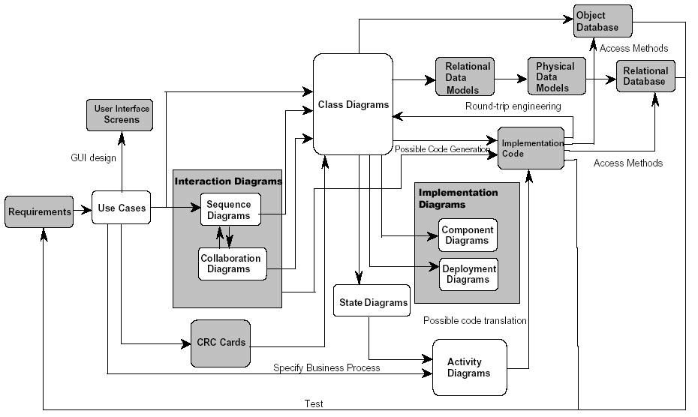
Overview of UML Diagrams

Slide 9
Use-Case Modeling
Applied to analyze functional requirements of the system
During the analysis phase: To understand functional requirements of the system without considering implementation details
Use Case
  A complete sequence of related actions initiated by an actor (e.g. registration, transaction)
Actor
  An external entity that interacts with the system

Slide 10
Use-Case Modeling
Developing Use-Case Diagrams
  Use cases are always initiated by an actor
  Use cases represent complete functionality of the system
Relationships Between Use Cases
  Use cases may participate in relationships with other use-cases
  Two types
    Extends
      Adds new behaviors or actions to a use case
    Include
      One use case references another use case

Slide 11
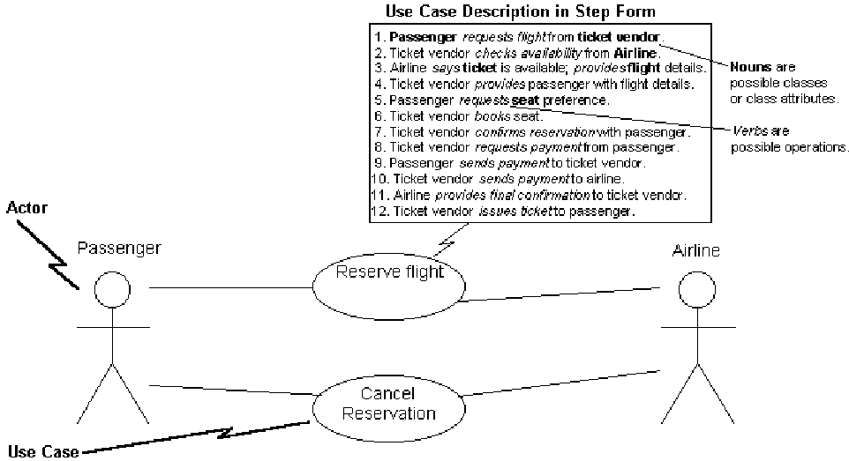
Preview of a Use Case Model Diagram

Slide 12
Use Case Modeling Building Blocks
Scenario: sequence of steps describing an interaction between a user (role) and a system
Use case: collection of scenarios linked by a common user goal of completing a single business task
  Emphasis on “what” rather than “how”
Actor: a role that interacts with the system to exchange information
  …could be an external system as well as a person
Temporal event: triggered by time.
  i.e., the actor of a temporal event use case is time
Use case modeling: modeling functions using events, initiators, and system responses

Slide 13
Member Services System Context (Model) Diagram (A.6)
Accounts
Club
Promotion
Receivable
Member
Member
Credit
Member Order
Status
Warehouse
various Inquiry Reponses
Revised Packing Order
Potential
New Subscription
Member
New Promotion
Member
Subscription Offer
Services
Subscription Program
System
Subscription Renewal
various Sales Reports
various
Promotion Reports
Marketing
Department
various Subscription Reports
Past
Member
Resubscription Offer
various Member
Member
Reports
Services
Used to help identify actors & use cases

Slide 14
Step 1: Identifying Actors and Use Cases
Actor
Potential
Member
Club
Member
Club
Member
Club
Member
Club
Member
Club
Member
Past
Member
Marketing
Marketing
Marketing
Time
Time
Time
Time
Time
Use Case Name
SUBMIT NEW
SUBSCRIPTION
PLACE NEW MEMBER
ORDER
MAKE ACCOUNT INQUIRY
MAKE PURCHASE INQUIRY
MAINTAIN MEMBER ORDER
SUBMIT CHANGE OF
ADDRESS
SUBMIT
RESUBSCRIPTION
SUBMIT NEW MEMBER
SUBSCRIPTION PROGRAM
SUBMIT PAST MEMBER
RESUBSCRIPTION
PROGRAM
SUBMIT NEW PROMOTION
GENERATE QUARTERLY
PROMOTION ANALYSIS
GENERATE QUARTERLY
SALES ANALYSIS
GENERATE QUARTERLY
MEMBERSHIP ANALYSIS
GENERATE ANNUAL SALES
ANALYSIS
GENERATE ANNUAL
MEMBERSHIP ANALYSIS
Use Case Description
Potential member joins the club by subscribing. (“Take anu 12 CDs for one penny and agree to buy 4 more at regular club prices within two years.”)
Club member places order.
Club member wants to examine his or her account history.
(90-day time limit)
Club member inquires about his/her purchase history.
(three-year time limit)
Club member wants to revise an order or cancel an order.
Club member changes address.
(including e-mail and privacy code)
Past member rejoins the club by resubscribing.
Marketing establishes a new membership resubscription plan to entice new members.
Marketing establishes a new membership resubscription plan to lure back former members.
Marketing initiates a promotion.
(Note: A promotion features specific titles, usually new, that company is trying to sell at a special price. These promotions are integrated into a catalog sent (or communicated) to all members.)
Print quarterly promotion analysis report.
Print annual sales analysis report.
Print annual membership analysis report.
Print annual sales analysis report.
Print annual membership analysis report.

Slide 15
Step 2: Constructing a Use Case Model Diagram
Order Subsystem
communication association
Subscription Subsystem
Maintain Member
Submit Change of
Submit New
Potential Member
Order
Address
Subscription
initiates
initiates
Club Member
initiates
Place New
initiates
Submit
Member Order
Resubscription
initiates
initiates
Make Purchase
Submit Past
Submit New
initiates
Inquiry
Member
Member
Past Member
Resubscription
Subscription
Program
Program
multiple actors per use case OK
initiates
Operations Subsystem
Promotion Subsystem
initiates
initiates
Make Account
Generate Quarterly
Inquiry
Membership
Time
Marketing
Analysis
initiates
Generate Annual
initiates
Generate Quarterly
Submit New
initiates
Sales Analysis
initiates
Promotion Analysis
Promotion
initiates
initiates
Generate Quarterly
Generate Annual
Sales Analysis
Membership
Analysis

Slide 16
Step 3: Documenting the Use Case Typical Course
Author: S. Shepard Date: 10/05/200
Use Case Name: Submit New Member Order
Actor(s): Member
Description: This use case describes the process of a member submitting an order for
SoundStage products. On completion, the member will be sent a notification that the order was accepted.
References: MSS-1.0
Typical Course
of Events:
1
Trace back to requirement
Actor Action
Step 1: This use case is
initiated when a member
submits an order to be
processed
Step 7: This use case
concludes when the
member receives the
order confirmation notice.
System response
Step 2: The member’s personal information such as address is validated against what is currently recorded in member services.
Step 3: The member’s credit status is checked with Accounts Receivable to make sure no payments are outstanding.
Step 4: For each product being ordered, validate the product number and then check the availability in inventory and record the ordered product information.
Step 5: Create a picking ticket for the member order containing all ordered products that are available and route it to the warehouse for processing.
Step 6: Generate an order confirmation notice indicating the status of the order and send it to the member.
2
Typical, not error-handling

Slide 17
Step 3: Documenting the Use Case Typical Course (concluded)
Alternate Step 2: If the club member has indicated an address or telephone number change on the promotion order, update the club member’s record with the new information.
Step 3: If Accounts Receivable returns a credit status that the customer is in arrears, send an order rejection notice to the member.
Step 4: If the product number is not valid, send a notification to the member requesting them to submit a valid product number. If the product being ordered is not available, record the ordered product information and mark as “back-ordered.”
Pre-condition:
Orders can only be submitted by members.
Post-condition: Member order has been recorded and the picking ticket has been routed to the warehouse.
Assumptions: None at this time.
3
4
5
6
Including potential interaction with non-functional requirements

Slide 18
Extension and Abstract Use Cases
Extension use case: extends the functionality (typical course) of an original use case
  May be contingent (need not always be invoked)
  Can only be invoked by the use case it is extending
  Usage: to decompose the complexity of a growing use case
Abstract use case: contains typical course steps that were common to two or more original use cases
  Reduces redundancy & promotes reuse
  Usage: when you want to avoid repetition

Slide 19
Depicting Extension and Abstract Use Cases using UML Notation
Generate Warehouse
Calculate Order Subtotal &
Packing Order
Sales Tax
“Extends”
Extension use
Extension use
case
case
Place New
Member Order
“Uses”
Revise Street
Address
Abstract use
case
Submit Change of Address

Slide 20
Step 4: The Analysis Use Case (include Extensions & Abstractions)
ANALYSIS USE CASE
Author: S. Shepherd Date: 10/25/2000
USE CASE NAME:
ACTOR(S):
DESCRIPTION:
REFERENCES
TYPICAL COURSE OF EVENTS:
Place New Member Order
Club Member
This use case describes the process of a club member submitting a new order for SoundStage products. On completion, the club member will be sent a notification that the order was accepted.
MSS-1.0
Actor Action
Step 1: This use case is initiated when a member submits an order to be processed.
Step 9: This use case concludes when the member receives the order confirmation notice.
System Response
Step 2: The member’s personal information such as address and phone number is validated against what is currently on file.
Step 3: For each product being ordered, validate the product number.
Step 4: For each product being ordered, check the availability in inventory and record the ordered product information such as the quantity being ordered.
Step 5: Invoke extension use case Calculate Order Subtotal & Sales Tax.
Step 6: The member’s credit card information is verified based on the amount due and Accounts Receivable transaction data is checked to make sure no payments are outstanding.
Step 7: Invoke extension use case Generate Warehouse Packing Order.
Step 8: Generate an order confirmation notice indicating the status of the order and send it to the member.
(continued)

Slide 21
Step 4: The Analysis Use Case (concluded)
ALTERNATE
COURSES:
PRECONDITION:
POSTCONDITION:
ASSUMPTIONS:
Step 2: If the club member has indicated an address or telephone number change on the order, invoke abstract use case Revise Street Address.
Step 3: If the product number is not valid, send a notification to the member requesting the member to submit a valid product number.
Step 4: If the product being ordered is not available, record the ordered product information and mark the order as “backordered.”
Step 6: If member’s credit card information is invalid or if member is found to be in arrears, a credit problem notice is sent to the member. Modify the order’s status to be “on hold pending payment.”
Orders can only be submitted by members.
Member order has been recorded and the Packing Order has been routed to the Warehouse.
None at this time.

Slide 22
Identifying, Organizing, Modeling Objects

Slide 23
Finding and Identifying Business Objects
Step 1: Find the Potential Objects
  Underlining / highlight the use case nouns
Step 2: Select the Proposed Objects
  Filter out the nouns that represent:
    Synonyms
    Nouns outside the scope of the system
    Nouns that are roles without unique behavior or are external roles
    Unclear nouns that need focus
    Nouns that are really actions or attributes

Slide 24
Use Case with Nouns Highlighted
ANALYSIS USE CASE
Author: S. Shepherd Date: 10/25/2000
USE CASE NAME:
ACTOR(S):
DESCRIPTION:
REFERENCES
TYPICAL COURSE OF EVENTS:
Place New Member Order
Club Member
This use case describes the process of a club member submitting a new order for SoundStage products. On completion, the club member will be sent a notification that the order was accepted.
MSS-1.0
Actor Action
Step 1: This use case is initiated when a member submits an order to be processed.
Step 9: This use case concludes when the member receives the order confirmation notice.
System Response
Step 2: The member’s personal information such as address and phone number is validated against what is currently on file.
Step 3: For each product being ordered, validate the product number.
Step 4: For each product being ordered, check the availability in inventory and record the ordered product information such as the quantity being ordered.
Step 5: Invoke extension use case Calculate Order Subtotal & Sales Tax.
Step 6: The member’s credit card information is verified based on the amount due and Accounts Receivable transaction data is checked to make sure no payments are outstanding.
Step 7: Invoke extension use case Generate Warehouse Packing Order.
Step 8: Generate an order confirmation notice indicating the status of the order and send it to the member.
(continued)

Slide 25
Use Case with Nouns Highlighted (conclusion)
ALTERNATE
COURSES:
PRECONDITION:
POSTCONDITION:
ASSUMPTIONS:
Step 2: If the club member has indicated an address or telephone number change on the order, invoke abstract use case Revise Street Address.
Step 3: If the product number is not valid, send a notification to the member requesting the member to submit a valid product number.
Step 4: If the product being ordered is not available, record the ordered product information and mark the order as “backordered.”
Step 6: If member’s credit card information is invalid or if member is found to be in arrears, a credit problem notice is sent to the member. Modify the order’s status to be “on hold pending payment.”
Orders can only be submitted by members.
Member order has been recorded and the Packing Order has been routed to the Warehouse.
None at this time.

Slide 26
Potential Objects Extracted from Use Case
POTENTIAL OBJECT LIST
Accounts Receivable Department
Amount Due
Club Member
Credit Card Information
Credit Problem Notice
Credit Status
File
Marketing Department
Member Address
Member Order
Member Phone Number
Member Services Department
Member Services System
Order
Order Confirmation Notice
Order Sales Tax
Order Status
Order Subtotal
Ordered Product
Ordered Product Information
Ordered Product Quantity
Past Member
Payments
Potential Member
Product
Product Inventory
Product Number
Street Address
Transaction
Warehouse
Warehouse Packing Order

Slide 27
Analysis of the Potential Objects
POTENTIAL OBJECT LIST
x
REASON
Accounts Receivable Department
x
Not relevant for current project
Amount Due
/
Attribute of “MEMBER ORDER”
Club Member
x
Type of “MEMBER”
Credit Card Information
x
Attribute of “MEMBER”
Credit Problem Notice
x
Potential Interface item to be addressed in object-oriented design
Credit Status
x
Attribute of “MEMBER”
File
x
Not relevant for current project
Marketing Department
x
Not relevant for current project
Member Address
/
Attribute of “MEMBER”
Member Order
x
“MEMBER ORDER”
Member Phone Number
x
Attribute of “MEMBER”
Member Services Department
x
Not relevant for current project
Member Services System
x
Not relevant for current project
Order
x
Another name for “MEMBER ORDER”
Order Confirmation Notice
x
Potential Interface item to be addressed in object-oriented design
Order Sales Tax
x
Attribute of “MEMBER ORDER”
Order Status
x
Attribute of “MEMBER ORDER”
Order Subtotal
/
Attribute of “MEMBER ORDER”
Ordered Product
x
“MEMBER ORDERED PRODUCT”
Ordered Product Information
x
Unclear noun
Ordered Product Quantity
/
Attribute of “MEMBER ORDERED PRODUCT”
Past Member
Type of “MEMBER”
Payments
/
Type of “TRANSACTION”
Potential Member
/
Type of “MEMBER”
Product
/
“PRODUCT”
Product Inventory
x
Attribute of “PRODUCT”
Product Number
x
Attribute of “PRODUCT”
Street Address
x
Attribute of “MEMBER”
Transaction
/
“TRANSACTION”
Warehouse
x
Not relevant for current project
Warehouse Packing Order
x
Potential Interface item to be addressed in object-oriented design

Slide 28
Results of Analysis
PROPOSED OBJECT LIST
CLUB MEMBER
MEMBER ORDER
MEMBER ORDERED PRODUCT
PAST MEMBER
PAYMENT
POTENTIAL MEMBER
PRODUCT
TRANSACTION
-- PLUS --
AGREEMENT
AUDIO TITLE
GAME TITLE
PROMOTION
MERCHANDISE
RETURN
TITLE
VIDEO TITLE

Slide 29
Use Case Modeling Benefits
To better communicate with domain experts
To reduce requirements-related risks
  Requirements verification
  Test case development
To better communicate with downstream implementation staff

Slide 30
Use-Case Example
(University registration System)
Student registers for classes. Registration clerk accepts this registration. When student registers for special classes, Instructor should permit student to take this class. For the case when student tries to register to a class whose prerequisite courses are not taken by the student, an extended use case will be initiated.
Bursar’s office sends bill for tuition. Then students send their tuition invoices by mail.

Slide 31
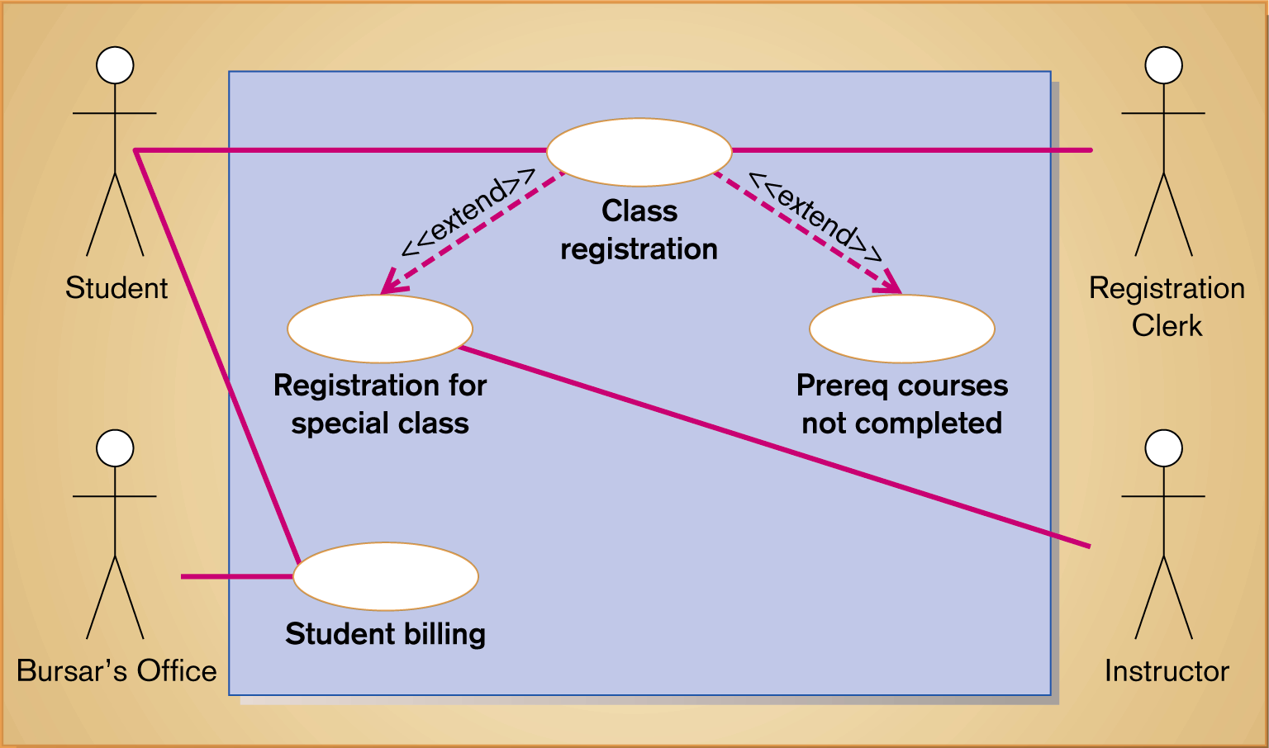
Figure 20-2
Use-case diagram for a university registration system

Slide 32
Use-Case Exercise
(Auto rental use case)
An auto rental company wants to develop an automated system that would handle car reservations, customer billing, and car auctions. Usually a customer reserves a car, picks it up, and then returns it after a certain period of time. At the time of pick up, the customer has the option to buy or waive collision insurance on the car. When the car is returned, the customer receives a bill and pays the specified amount. In addition to renting out cars, every six months or so, the auto rental company auctions the cars than have accumulated over 20,000 miles. Draw a use-case diagram for capturing the requirements of the system to be developed. Include an abstract use case for capturing the common behavior among any two use cases. Extend the diagram to capture corporate billing, where corporate customers are not billed directly; rather, the corporations they work for are billed and payments are made sometime later.

Slide 33
Overview of UML Diagrams

Slide 34

Objects
Object: a “real” thing in the user world
  Capable of being seen, touched, or otherwise sensed
  Has a name
  Users can describe attributes (characteristics) about them and associate behaviors (operations) with them

Slide 35
Classes
A class (object class) describes a set of objects that share common attributes and behaviors
Book
ISBN
type
title
copyright
Open()
Close()

Slide 36
Attributes
Attributes: data about a class
  Have primitive data types (integer, real, string, etc.)
Constraint: a limiting condition on an attribute
  Example: the “quantity ordered” attribute of an “order” cannot be a negative number
  Not to be confused with a managerial constraint (Ch.5)

Slide 37
Behaviors
Behavior (operation): a function (“verb”) that a class performs
  Other classes can utilize one class’s behaviors to gain access to its attribute values
  Behaviors often expect arguments (“adverbs”) qualifying how the behavior is to be carried out
  Other “raw materials” that are fed into the behavior are the attribute values themselves
Implicit behaviors that all classes possess:
  Create & delete new object instances
  Update attributes
  Display attribute values
Example:
  “DisplayOrderQuantity(OrderNumber)” for an “Order” class

Slide 38
Object Instances
Instance: computerized representation of a real object
  Created as a new member of a class… therefore it has a name, attributes & behaviors
Lonnie
home phone =
317-463-9593
street =
2625 Darwin Dr.
city =
West Lafayette
state =
Indiana
0256101329: Book
47906
0256102219: Book
ISBN = 0256101329
ISBN = 0256102219
type = textbook
type = workbook
title = Systems Analysis & Design Methods
title = Projects and Cases to Accompany SADM
copyright = 1996
copyright = 1996

Slide 39
Encapsulation
Encapsulation (information hiding): hiding the details behind exactly how a behavior is carried out
  For the “DisplayOrderQuantity(OrderNumber)” example above, we don’t know whether the Order instance gets the data from a flat file or an elaborate relational database or the Web or by sending an e-mail to a human actor or…
  The implementation details are hidden or encapsulated

Slide 40
Object Modeling
Class Diagrams
Class Diagram
  Class is represented as a rectangle with three compartments
  Objects can participate in relationships with objects of the same class
Object Diagram
  A graph of instances that are compatible with a given class diagram; also called an instance diagram
  Object is represented as a rectangle with two compartments

Slide 41
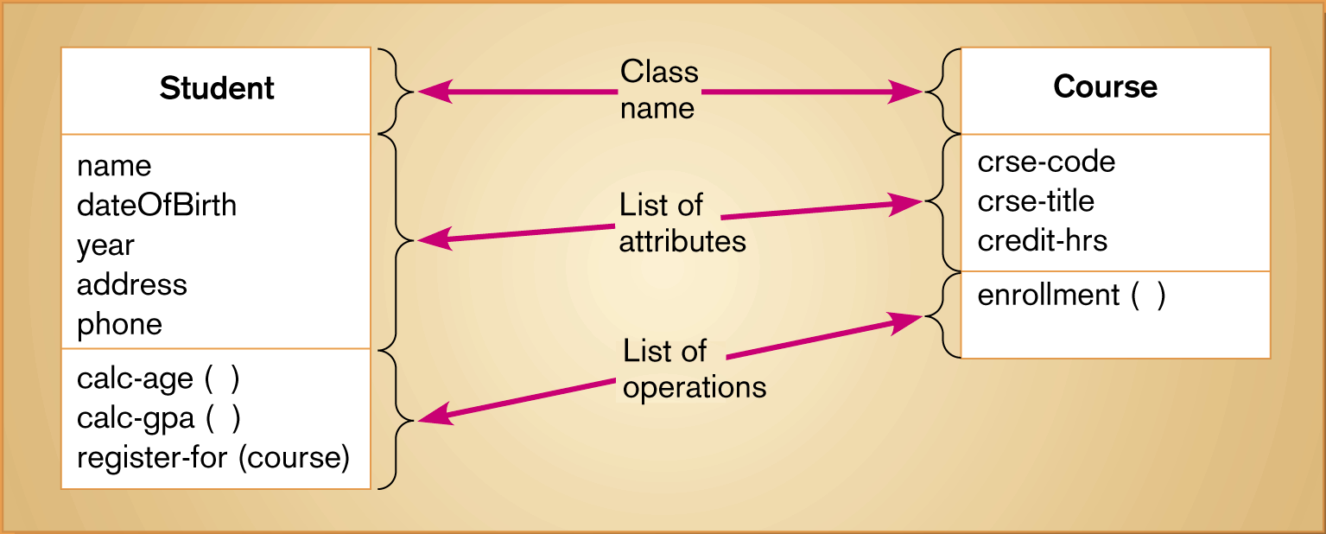
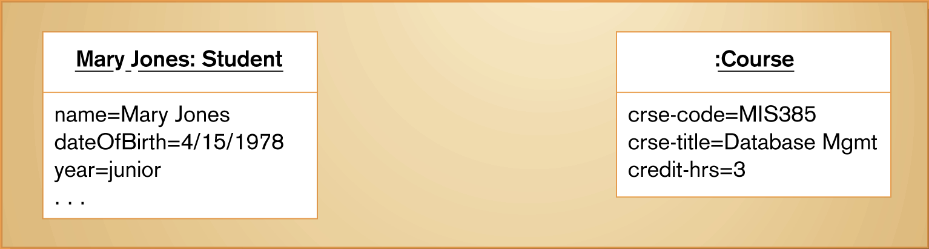
Figure 20-5
UML class and object diagrams
(a) Class diagram showing two classes
(b) Object diagram with two instances

Slide 42
CRC Cards

Slide 43
Motivation for Class-Responsibility-Collaboration Cards
A problem: have we created all the classes and identified all attributes and behaviors?
…or are some still missing?

Slide 44
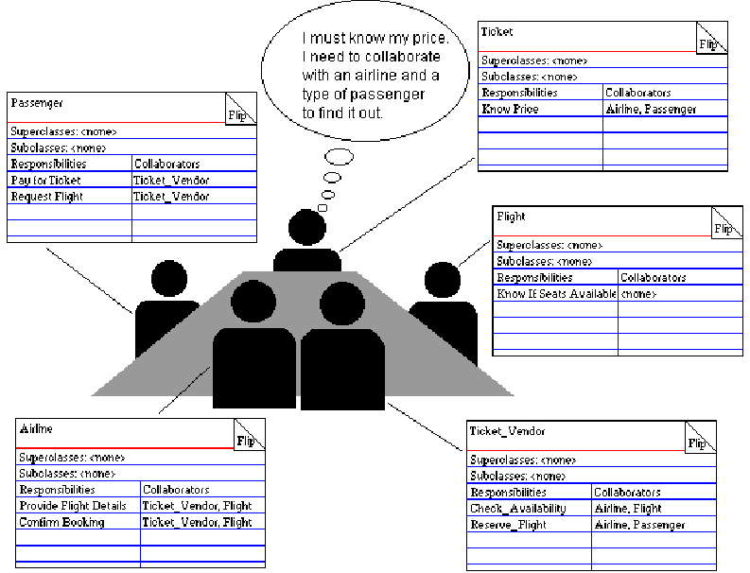
Class-Responsibility-Collaboration (CRC) Cards
(airline example)
“JRP/JAD meets OO”

Slide 45
Example CRC Card (Soundstage)
Object Name: Member Order
Sub Object:
Super Object:
Behaviors and Responsibilities
Collaborators
Report order information
Member Ordered Product
Calculate subtotal cost
Calculate sales tax
Update order status
Create ordered product
Delete ordered product
In addition to the implicit behaviors

Slide 46
Class Diagram Building Blocks

Slide 47
Class Relationships
Class relationship: association between classes
  Generalization/specialization (supertype/subtype): one class is a more specific description of the other
  Aggregation: members of a set
  Association: all other class relationship types
Multiplicity
places
0..*
Customer
Order
requestor
Role Name: what role is the class playing for this particular relationship (there may also be other relationships having other roles)
Navigability

Slide 48
More Properties of Relationships
Multiplicity: how many instances of one class can be associated with one instance of another
Navigability: constrains the relationship to operating in only one direction:
  Instances of the class at arrow tail can query data from instances class at arrow head, but not the reverse
  If no navigability arrow: requests can flow both directions

Slide 49
Generalization/Specialization
Inheritance: behaviors and attributes defined in one class can be inherited (re-used) by another class
Generalization/specialization (generalization): a technique where the attributes and behaviors that are common to several partially-different types of classes are grouped under their own supertype class
  Supertype attributes & behaviors are then inherited by those object classes
  The relationship can be characterized as the “is a more specific description of” relationship

Slide 50
“Org Chart” Representation of Generalization (University example)
Supertype (base class, parent, superclass): the class whose instances store attributes common to one or more subtype instances
Subtype (derived class, child, subclass): the class whose instances inherit common attributes from the supertype, then add other unique attributes
Person Class
(supertype)
Student Class
Teacher Class
(subtype)
(subtype)
Student A
Student B
Student C
Teacher A
Teacher B
Instances

Slide 51
Formal UML Representation (for the same example)
Person
last name
first name
birthdate
gender
walk()
jump()
talk()
sleep()
eat()
etc.()
“is a more specific description of…”
Student
Teacher
GPA
rank
classification
enroll()
lecture()
displayGPA()

Slide 52
Polymorphism
Polymorphism (“many forms”): a supertype behavior may be completed differently for different subtypes
  Enables subtypes to override the default features of their supertypes
  The resulting behavior is often called a method (service, method body)

Slide 53
Multiple Inheritance & Multiple Classification
Multiple Inheritance: multiple supertypes for a single subtype
Multiple Classification: multiple supertypes for a single instance
Both constructs are somewhat controversial
  Not allowed in Java (yet?)
  OK in C++

Slide 54
Sample Multiplicity Notations (ignore left sides)
UML
Association
Multiplicity
Multiplicity
Association with Multiplicity
Meaning
Notation
Employee
Works for
1
Department
1
An employee
Exactly 1
or
works for one
Works for
and only one
leave blank
Employee
Department
department.
Has
0..1
An employee has
Zero or one
0..1
Employee
Spouse
either one or no
spouse.
Customer
Makes
0..*
Payment
0..*
A customer can
Zero or
or
make no payment
more
Makes
*
up to many
*
Customer
Payment
payments.
Offers
1..*
A u
niversity
One or more
1..*
University
Course
offers at least 1
course up to
many courses.
Has
A team has either
Specific
7..9
Team
scheduled
7..9
Game
7, 8, or 9 games
range
scheduled

Slide 55
The Composite Aggregation (“part of”) Relationship
Book
1
0..1
1..*
0..1
Cover
Table of
Contents
Chapter
Index
1..*
For example, if a Chapter instance is deleted, all children (Page, Paragraph, etc.) will also be deleted
Page
Solid diamond indicates composition aggregation relationship
(“cannot exist without…”)
0..*
Paragraph
1..*
Word

Slide 56
The Shared Aggregation (“part of”) Relationship
Team
0..*
Hollow diamond indicates Shared aggregation relationship
(“can exist without”)
0..*
Player
An instance of “Team” can be deleted without causing the related “Player” instance to be deleted

Slide 57
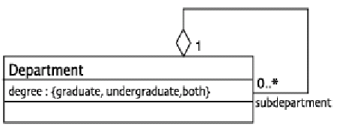
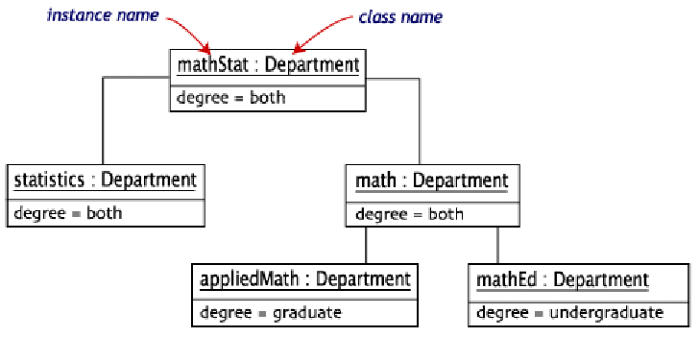
Applying Aggregation to Create an Object Diagram
Object Diagrams show particular instances of classes
  Example: complex object diagram from a simple class:

Slide 58
Class Diagram Examples

Slide 59
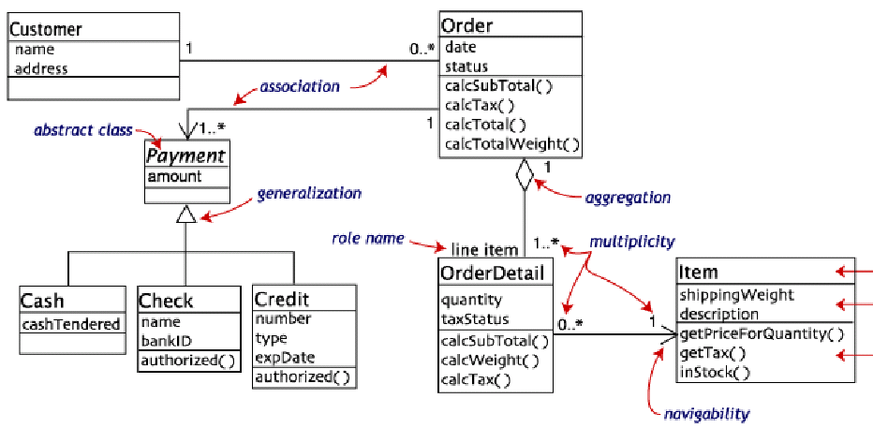
Annotated Class Diagram (retail product ordering)

Slide 60
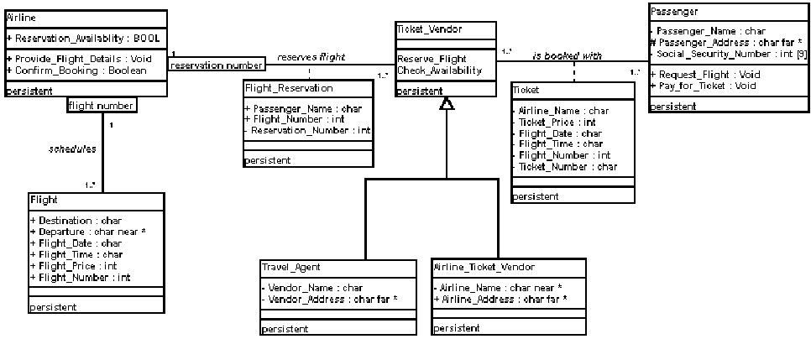
Qualified Associations & Association Classes (airline)
Association Class = attributes + behaviors attached to a relationship (could be promoted to a full class if needed; can be thought of as a contract document linking the parties)
Qualified Association : enables collaborator to distinguish among many instances of the same class (like a “key” in a DB)

Slide 61
Soundstage Member Services System Class Diagram
Member
Member-Number
Member-Name
Member-Status
Member-Street-Address
Member-PO-Box
Member-City
Member-State
Member-Zip-Code
persistent
<<actor>>
<<actor>>
<<actor>>
Potential Member
Club Member
Past Member
Member-Date-Of-Last-Order
Expiration-Date
Agreement
Member-Daytime-Phone-Number
persistent
Member-Credit-Card-Expire-Date
Member-Credit-Card-Number
Agreement-Number
Member-Credit-Card-Type
persistent
Agreement-Expire-Date
Member-Balance-Due
Agreement-Active-Date
Member-Bonus-Balance-Available
1..*
Fulfillment-Period
Has
purchased
Audio-Category-Preference
Required-Number-Of-Credits
Audio-Media-Preference
binds
1
Date-Enrolled
1
Email-Address
persistent
0..*
Game-Category-Preference
Product
Game-Media-Preference
Member Ordered Product
Number-Of-Credits-Earned
Product-Number
Privacy-Code
UPC-
Quantity-Ordered
Video-Category-Preference
Transaction
Quantity-In-Stock
Quantity-Shipped
Video-Media-Preference
1
Conducts
Product-Type
1
Sold as
Quantity-Backordered
Transaction-Reference-Number
Suggested-Retail-Price
Purchase-Unit-Price
persistent
Transaction-Date
Default-Unit-Price
Credits-Earned
Transaction-Type
Current-Special-Unit-Price
0..*
0..*
Transaction-Description
Current-Month-Units-Sold
Transation-Amount
Current-Year-Units-Sold
persistent
1
Total-Lifetime-Units-Sold
1..*
Places
persistent
persistent
Sells
0..*
Return
Member Order
Merchandise
Title
1
Order-Number
Order-Creation-Date
persistent
Merchandise-Name
Promotion
Order-Fill-Date
Merchandise-Description
Title-Of-Work
Shipping-Address-Name
Merchandise-Type
Title-Cover
1..*
Promotion-Number
Generates
Shipping-Street-Address
Unit-of-Measure
Catalog-Description
Promotion-Release-Date
Shipping-City
Copyright-Date
Features
0..*
Promotion-Status
0..1
Shipping-State
Entertainment-Company
Promotion-Type
0..*
Shipping-Zip-Code
Credit-Value
Shipping-Instructions
persistent
Order-Sub-Total
persistent
Order-Sales-Tax
persistent
Order-Shipping-Method
Order-Shipping-&-Handling-Cost
Order-Status
Order-Prepaid-Amount
Order-Prepayment-Method
Audio Tilte
persistent
Artist
Video Title
Game Title
Audio-Category
Producer
Manufacturer
Audio-Sub-Category
Director
Game-Category
Number-Of-Units-In-Package
Video-Category
Game-Sub-Category
Audio-Media-Code
Video-Sub-Category
Game-Platform
Content-Advisory-Code
Closed-Captioned
Game-Media-Type
Language
Number-Of-Players
Running-Time
Parent-Advisory-Code
Video-Media-Type
persistent
Video-Encoding
Screen-Aspect
persistent
MPA-Rating-Code
persistent

Slide 62
Package Diagrams

Slide 63
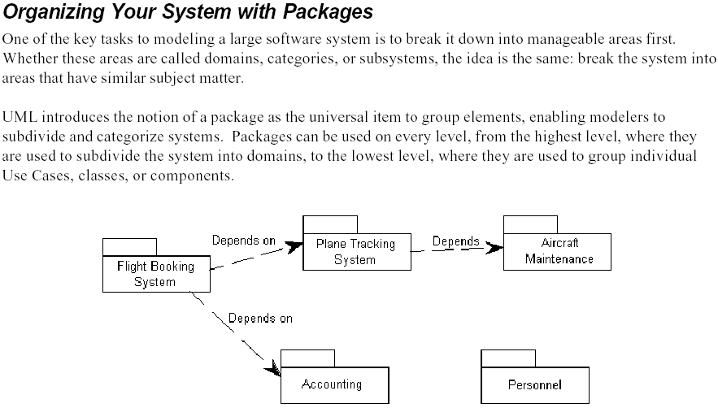
Packages & Package Diagrams (airline)

Slide 64
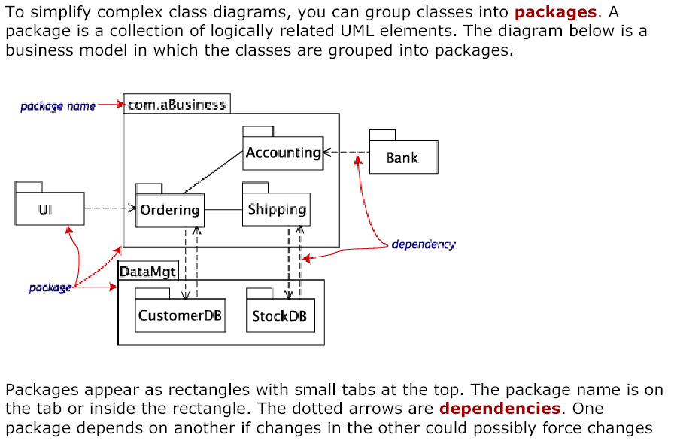
Annotated Package Diagram (retail)

Slide 65
When to Use Packages?
When the Class Diagram for the entire system is no longer readable on a single standard sheet of paper

Slide 66
Sequence Diagrams

Slide 67
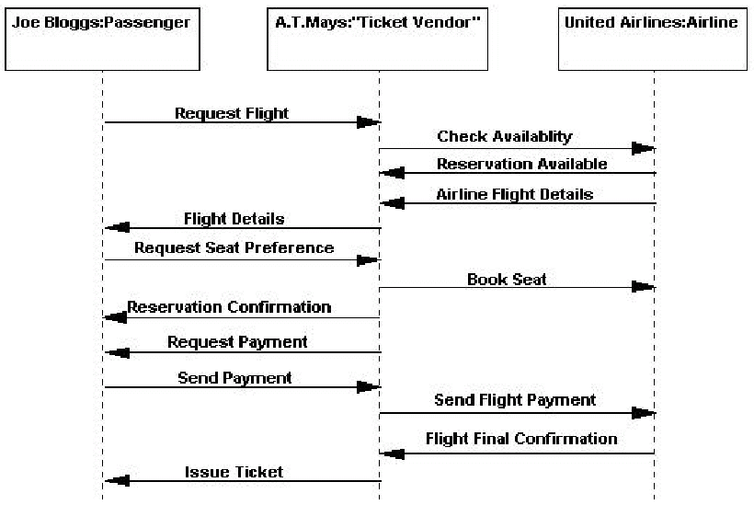
Sequence Diagram for the Airline Ticketing Scenario

Slide 68
Messages (Soundstage)
A message is passed when one class invokes another class's behavior to request information or some action
Customer
Order
Desired attribute
customer number
order number
last name
order date
first name
order status
home phone
etc.
street
Behavior
add order
city
display status
modify order
state
of order 23161
delete order
zipcode
display status
etc.
etc.
Argument
changeAddress()

Slide 69
Soundstage Product Order
an Order
Processor
a Club
Member
a Product
a Member
Order
a Member
Ordered Product
verify member
(member number)
display member information
update address (address)
select new order
enter item (product number)
create item
validate item

Slide 70
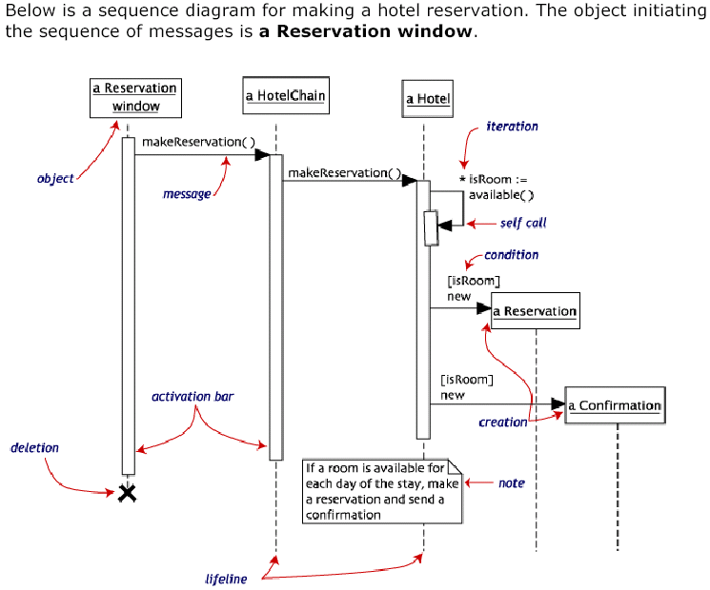
Annotated Sequence Diagram (Hotel Reservation)
Synchronous (blocks caller)

Slide 71
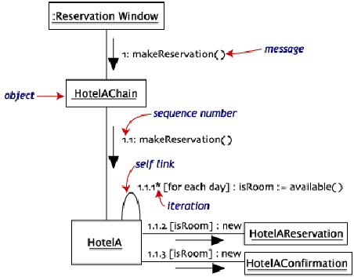
Collaboration Diagram (variation of Sequence Diagram)

Slide 72
When to Use Sequence Diagrams
When examining the behavior of multiple objects in a single use case or single course of events
Not when examining the behavior of a single object across multiple use cases
  Use a State or Activity Diagram instead

Slide 73
Sequence Diagram Example
(University Registration)
Registration clerk opens the registration window and enters the registration information (student and class)
Check if the class is open.
If the class is open, check if the course has any prerequisites.
If the course has prerequisites, then check if the student has taken all of those prerequisites.
If the student has taken those prerequisites, then register the student for the class, and increment the class size by one.
Check if the class is full; if not, do nothing.
Display the confirmed registration in the registration window.

Slide 74
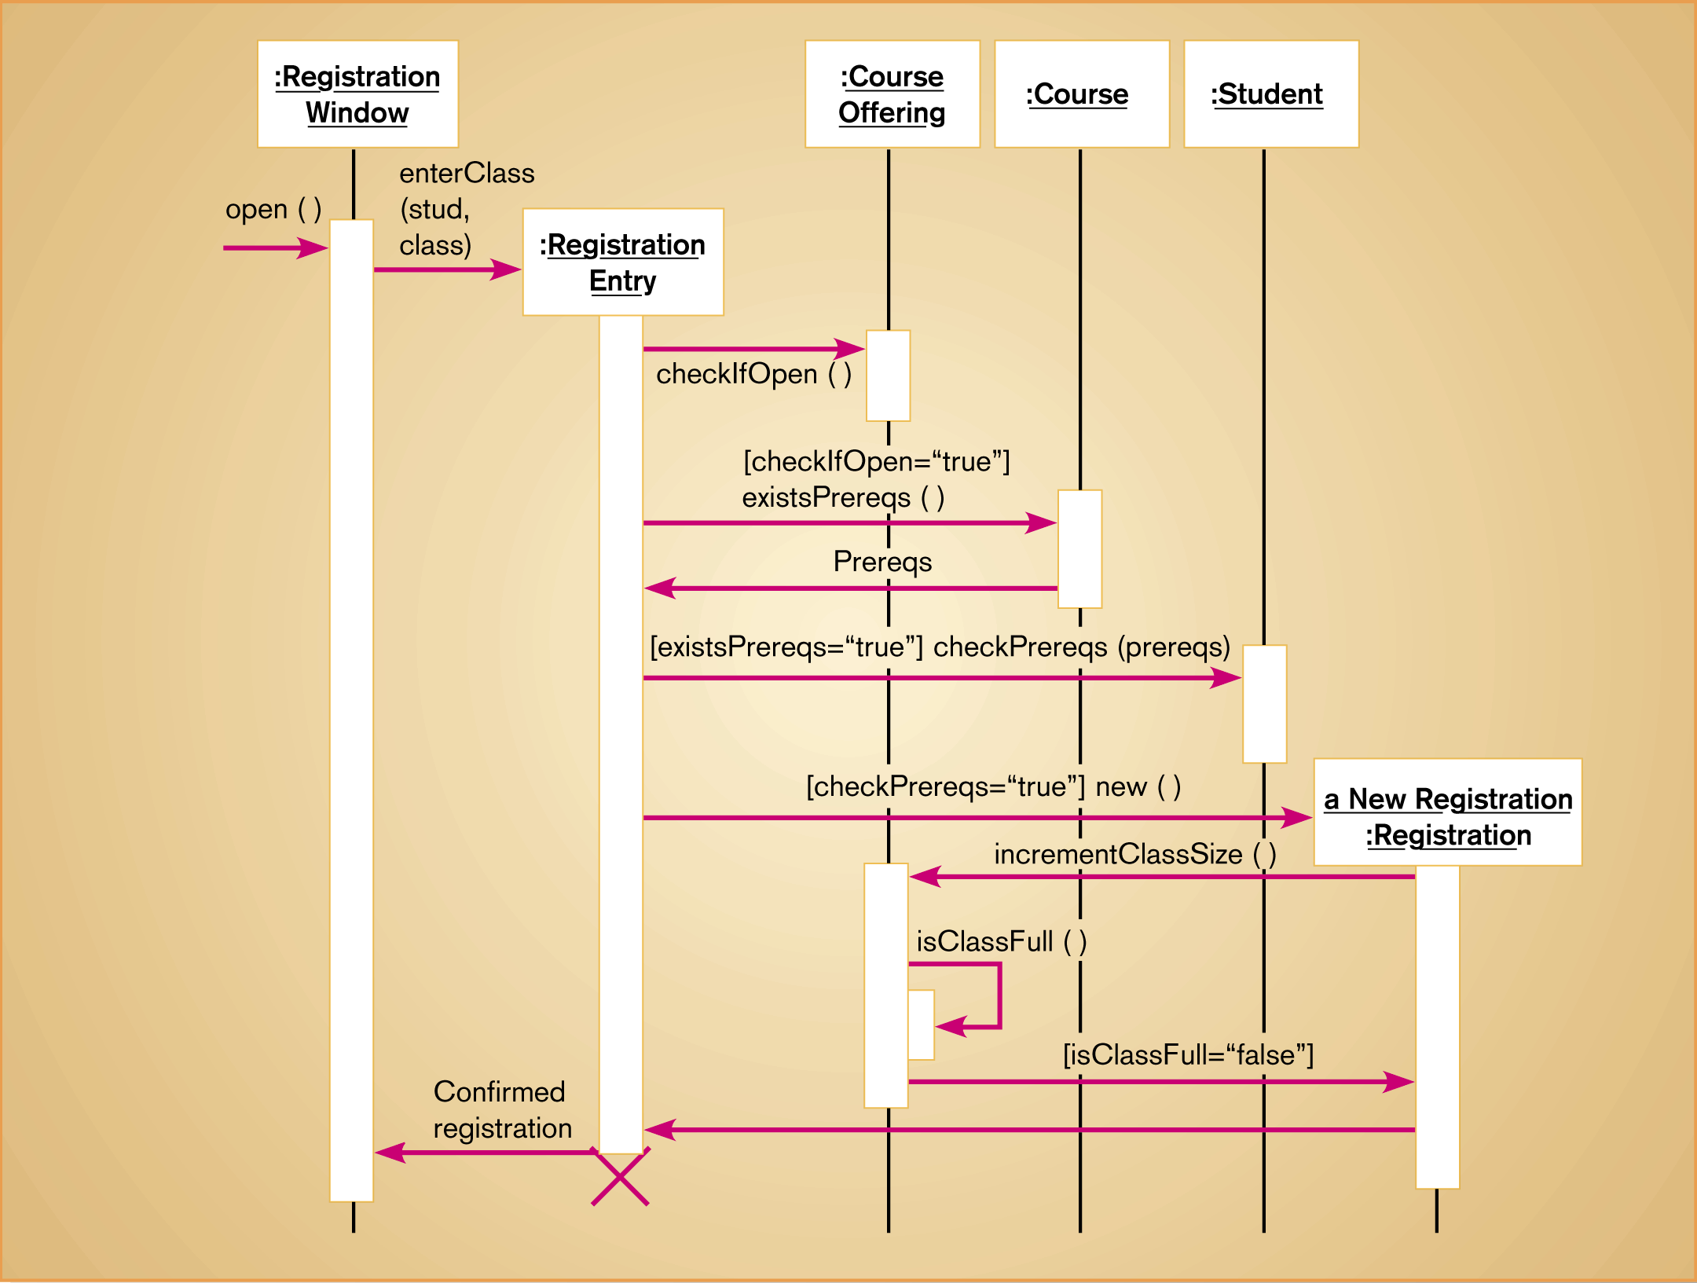
Figure 20-24
Sequence diagram for a class registration scenario with prerequisites

Slide 75
Sequence Diagram Exercise
(Hosier Burger Hire employee Use case)
On receipt of an application for a job at Hoosier Burger, the data relating to the applicant is entered through the applaction entry window.
The manager opens the application review window and reviews the application.
If the initial review is negative, the manager discards the application and conveys the rejection decision to the applicant. No further processing of the application is involved.
If the initial review is positive, then the manager sets up a date and time to interview the applicant. The manager also requests the references specified in the application for recommendation letters.
The manager interviews the candidate and enters the additional information gathered during the interview into the application file.

Slide 76
Sequence Diagram Exercise (Cont’d)
(Hosier Burger Hire employee Use case)
When the recommendation letters come in, the manager is ready to make a decision. First, he or she prepares a summary of the application. Based on the summary, he or she then makes a decision. If the decision is to reject the candidate, the application is discarded and the decision is conveyed to the applicant. The processing of the application comes to an end.
If the decision is to hire the candidate, a potential employee file is created and all relevant information about the candidate (e.g., name, social security number, birthdate, address, phone, etc.) is entered into this file. The hiring decision is conveyed to the applicant.

Slide 77
State & Activity Diagrams

Slide 78
Object State Example
Possible "States" of the Space
Shuttle
"Takeoff"
"PRE-LAUNCH"
"FLIGHT"
state
state

Slide 79
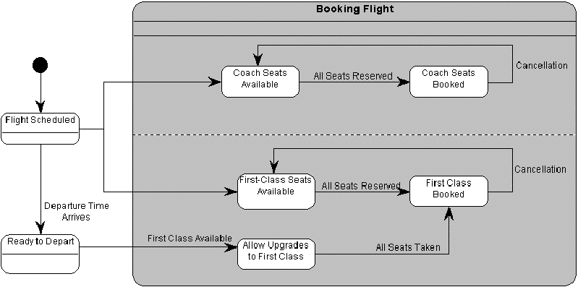
State (Real Time Model) Diagram Example (airline)

Slide 80
Soundstage Member Order State Diagram
Order Backordered
Not all product
available
Product received
Order pending awaiting payment or additional member information
Member Order
initial state
Order submitted
In Process
Pending
Response received from member
Order released
to the warehouse
Order Released
Order filled by the warehouse
Order Filled
Order shipped to club member
Order rejected based on Member's past history
Order Invoiced
Invoice sent to member for payment
Order Shipped
Final payment received
Order Closed
Member Order final
state
Member order archived after 90 days
Member Order final
state

Slide 81
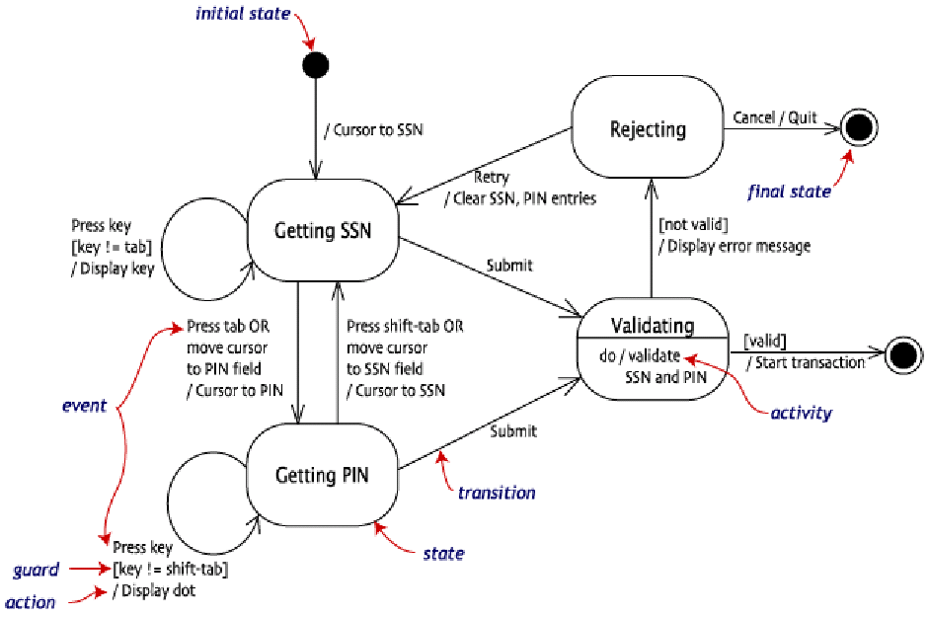
Annotated State Diagram: Login to Online Banking
Things “happen” on the links…
Actions are atomic (can’t be interrupted);
activities are not
(can be interrupted
True/False

Slide 82
When to Use State Diagrams
To examine of object behavior across several use cases
Particularly useful for domains that present unpredictable events and complex interactions
  Real-time control systems
  24x7 web applications

Slide 83
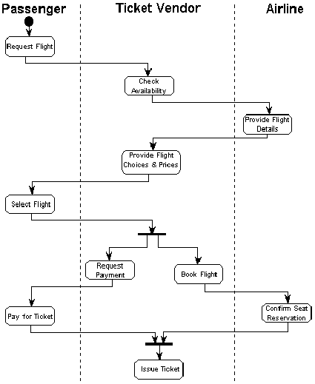
A Simple Activity Diagram (airline ticketing)
Things “happen” on the nodes…

Slide 84
More Elaborate: Soundstage Procurement
Input Request
Route to
Manager
Evaluate
Check
Need
Budget
[budget]
[need]
[no need]
[no budget]
Disapprove
Request
Technically, this should be a diamond shape (merge), but the damage of using a bar (join) is minimal
Route to
Approve
Purchasing Agent
Request

Slide 85
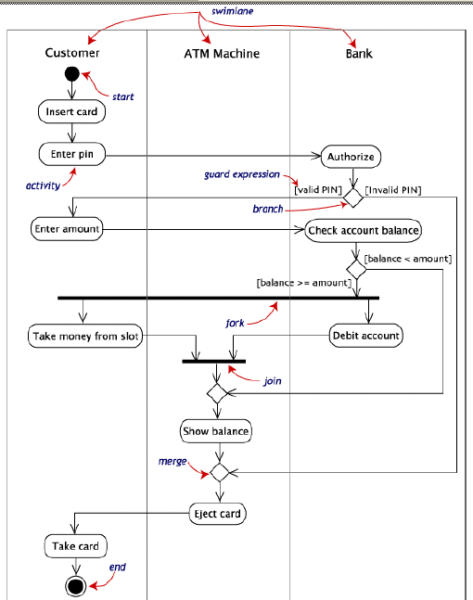
Annotated Activity Diagram (ATM withdrawal)
What’s the difference between branch/merge and fork/join?

Slide 86
When to Use Activity Diagrams
To model use cases
  Can even be used to replace the scenarios comprising use case details, particularly if many steps can occur in parallel
To model classes
  When all or most of the events represent the completion of internally-generated actions
Be sure to assign activities to classes while the activity diagramming knowledge is still fresh
Not to see how instances interact (use a Sequence Diagram)
or how an object behaves over its lifetime or responds to asynchronous events (State Diagram)
or to represent complex conditional logic (Decision Table [Ch.8])

Slide 87
System Design
System design (physical design): specification of a detailed, computer-based solution that emphasizes technical and implementation concerns
  User participation is often reduced to just an approval role in this phase, leaving the detailed work to the engineers

Slide 88
Defining the Design Use Case (Soundstage)
DESIGN USE CASE
Intermediate actor added? How does the member communicate with the system?
Author: S. Shepherd Date: 11/25/2000
USE CASE NAME:
ACTOR(S):
DESCRIPTION:
REFERENCES
TYPICAL COURSE OF EVENTS:
Place New Member Order
Club Member -- System user: Order Specialist
This use case describes the process of a club member submitting a new order for SoundStage products. On completion, the club member will be sent a notification that the order was accepted.
MSS-1.1
Actor Action
The main window is currently displayed on the screen waiting for the order specialist to select a menu option.
Step 1: When a new order is received from the club member, this use case is initiated when the order specialist selects the option “Process New Member Order.”
Step 3: The promotion order specialist enters the MEMBER NUMBER and clicks [OK].
System Response
Step 2: The system displays a dialogue window requesting the club member’s number be entered.
Step 4: The system verifies that the number is valid and if it is, retrieves and displays the following club member information: MEMBER NAME, MEMBER STATUS, MEMBER STREET ADDRESS, MEMBER P.O. BOX, MEMBER CITY, MEMBER STATE, MEMBER ZIP, MEMBER DAYTIME PHONE NUMBER, and MEMBER EMAIL ADDRESS, along with a menu button labeled “Update Member.” The system also displays two “read-only” windows containing order related fields (all currently blank). The first window contains ORDER NUMBER, ORDER CREATION DATE, SUBTOTAL COST, SALES TAX, and ORDER STATUS. The second window contains the individual ordered products. This is a multi-lined, scrollable window containing the fields: PRODUCT NUMBER, DESCRIPTION, QUANTITY AVAILABLE, QUANTITY ORDERED, QUANTITY BACKORDERED, SUGGESTED RETAIL PRICE, PURCHASED UNTI PRICE, EXTENDED COST, and CREDITS EARNED.
Compare to the Analysis Use Case from Chapter 6. Note especially the additional actor interface details here.

Slide 89
Defining the Design Use Case (cont’d.)
TYPICAL COURSE OF EVENTS:
Step 5: The order specialist checks to see if the club member has made any address or phone number changes on the order. If changes have been made the order specialist clicks the [Update member] menu button - invoke abstract use case Revise Street Address. Otherwise, the order specialist clicks [Enter Ordered Product] menu button.
Step 7: The order specialist enters the PRODUCT NUMBER of the item being ordered and then presses [Enter].
Step 9: The order specialist enters the QUANTITY ORDERED and a PURCHASE UNIT PRICE if it differs from the SUGGESTED RETAIL PRICE and presses [Enter]. If PURCHASE UNIT PRICE is not entered it will default to the SUGGESTED RETAIL PRICE.
Step 12: If the order specialist click [Yes] go back to Step 5.
Step 6: The System displays a dialogue window prompting the user to enter the PRODUCT NUMBER.
Step 8: The system validates the product number and then retrieves and displays the DESCRIPTION, CREDIT VALUE, QUANTIY IN STOCK, and SUGGESTED RETAIL PRICE. The cursor is then advanced to the QUANTITY ORDERED field.
Step 10: The system validates the inputs then calculates the new EXTENDED COST by multiplying the PURCHASE UNIT PRICE times the QUANTITY ORDERED.
If the QUANTITY ORDERED is greater than the QUANTITY IN STOCK, the system calculates QUANTITY BACKORDERED by subtracting QUANTITY IN STOCK from QUANTITY ORDERED. The system displays all fields in the ordered product read-only window.
Step 11: The system displays a window with the message “Is the Ordered Product Information Correct?” If no go to Step 7. If yes the system displays another window with the message “Additional Products to be Entered?”
Step 13: The system assigns a unique ORDER NUMBER, and an ORDER STATUS of “O,” then calculates ORDER SUBTOTAL and ORDER SALES TAX - invoke extension use case Calculate Order Subtotal & Sales Tax. The system displays all fields in the Order read-only window and then displays the message “Commit Order?” - [Yes] or [Cancel].

Slide 90
Defining the Design Use Case (conclusion)
TYPICAL COURSE OF EVENTS:
ALTERNATE COURSES:
PRECONDITION:
POSTCONDITION:
ASSUMPTIONS:
Step 14: The order specialist clicks [Yes].
Step 17: This use case concludes when the system displays a message “Order 1237645 has been processed successfully, would you like to enter another?”
If the order specialist clicks [Yes] the use case is repeated. If the order specialist clicks [No], the main system window is displayed.
Step 15: The system reduces the QUANTITY IN STOCK by the QUANTITY ORDERED for each product being ordered (replace any negative result with zero) and then saves all entries. Then the system verifies the member’s status and creditworthiness - invoke abstract use case Verify Club member Status.
Step 16: The system generates a packing order - invoke extension use case Generate Warehouse Packing Order, and generates an order confirmation notice indicating the status of the order - invoke abstract use case Generate Order Confirmation Notice.
If there were and invalid entries submitted by the club member invoke abstract use case Generate Order Error Report.
These were in Steps 7 and 8 in the Analysis Use Case
Abstract use cases may be good candidates for control objects (in the application logic layer in between the other two)
Step 4: If the MEMBER NUMBER is invalid, the system displays a window with the error message “Member Number Not on File.” The order specialist can then re-enter the number or cancel the transaction.
Step 8: If the PRODUCT NUMBER is not valid, the system displays a window with the error message “Product Number not Valid.” The order specialist either corrects the entry or advances to the next entry. In a later step, an error report will be generated for any invalid entries.
Step 10: If the QUANTITY ORDERED or PURCHASE UNIT PRICE is not valid, the system highlights the field(s) in error and then displays a window with the error message “Highlighted fields invalid.” The order specialist either corrects the entry or advances to the next entry. In a later step an error report will be generated for any invalid entries.
Step 13: If any of the products being ordered is not available, record the order status as “P” (partially filled).
Step 16: If member’s credit card information is invalid or if the member is found to be in arrears, a credit problem notice is sent to the member. Modify the order’s status to be “H” - on hold pending payment. Exit transaction.
Order specialist has logged on the system and has authorization for this transaction.
Member order has been recorded, the Packing Order has been routed to the Warehouse, and a confirmation notice has been generated and sent to the club member.
None at this time.

Slide 91
Classify Design Objects: Interface, Control, Entity
INTERFACE OBJECTS
CONTROL OBJECTS
ENTITY OBJECTS
Member Services Main Window
Order Processor
CLUB MEMBER
Club Member Number Dialogue
Packing Order Generator
MEMBER ORDER
Window
Order Processing Main Window
MEMBER ORDERED PRODUCT
Club
Member Window
PRODUCT
Order Window
Member Ordered Products
Window
Product Dialogue Window
Message Window
Warehouse Printer
Often the most difficult to design because nonfunctional requirements such as system capacity and throughput will eventually be addressed here
At least one per actor; will contribute to detailed user interface design later
Will become data modeling entities later

Slide 92
Design Object Types
Entity Objects: represent persistent data
  Database layer
Control Objects: application logic
  Business Rules
Interface Objects: user interface
  Presentation Layer
Entity
Control
Interface
<

Slide 93
Ideal Object Model: New Member Order
Extremely simplified…
Member Services Main Window
Club Member
Club Member
Order Specialist
Order
Processor
The Order Processing Main
window contains several sub
Member Order
windows that are not shown
Order Processing Main Window
Member Order object
Warehouse
includes Transaction
object attributes
Warehouse Printer
Member
Ordered
Product
Packing Order Generator
Product

Slide 94
Class Diagram with Attributes
Member
Member-Number
Member-Name
Member-Status
Member-Street-Address
Member-PO-Box
Member-City
Member-State
Member-Zip-Code
persistent
<<actor>>
Product
Club Member
Product-Number
Member-Date-Of-Last-Order
UPC-
Has purchased
Member-Daytime-Phone-Number
Quantity-In-Stock
Member-Credit-Card-Expire-Date
Product-Type
Member-Credit-Card-Number
Suggested-Retail-Price
1
Member-Credit-Card-Type
Default-Unit-Price
1
Sold as
Member-Balance-Due
Current-Special-Unit-Price
Member-Bonus-Balance-Available
Current-Month-Units-Sold
Audio-Category-Preference
Current-Year-Units-Sold
0..*
Audio-Media-Preference
Total-Lifetime-Units-Sold
Date-Enrolled
Member Ordered Product
Email-Address
Transaction
Game-Category-Preference
persistent
Quantity-Ordered
Game-Media-Preference
Transaction-Reference-Number
Quantity-Shipped
Number-Of-Credits-Earned
Transaction-Date
Quantity-Backordered
Privacy-Code
Transaction-Type
Purchase-Unit-Price
Video-Category-Preference
Conducts
Transaction-Description
Credits-Earned
Video-Media-Preference
1
0..*
Transation-Amount
0..*
persistent
persistent
persistent
1..*
Title
Title-Of-Work
1
Title-Cover
Member Order
Catalog-Description
Copyright-Date
Order-Number
Entertainment-Company
Order-Creation-Date
Credit-Value
Order-Fill-Date
Places
Shipping-Address-Name
persistent
Shipping-Street-Address
Shipping-City
Shipping-State
0..*
Shipping-Zip-Code
Shipping-Instructions
Order-Sub-Total
Sells
Order-Sales-Tax
Order-Shipping-Method
1
Order-Shipping-&-Handling-Cost
Order-Status
Order-Prepaid-Amount
Order-Prepayment-Method
persistent
Additional attributes due to additional design details… helps identify everything that feeds into data modeling

Slide 95
Update Behaviors and Responsibilities
BEHAVIORS
AUTOMATED/MANUAL
OBJECT TYPE
Process new member order
Manual/Automated
Control
Submit new order
Manual
Select process new member order option
Manual
Display club member number dialogue window
Automated
Interface
Enter member number
Manual
Verify member number
Automated
Entity
Retrieve club member information
Automated
Entity
Display club member information
Automated
Interface
Display blank order window
Automated
Interface
Display blank member ordered products window
Automated
Interface
Check for address changes
Manual
Click button
Manual
Display product number dialogue window
Automated
Interface
Enter product number & press enter
Manual
Validate product number
Automated
Entity
Retrieve product information
Automated
Interface
Advance cursor
Automated
Interface
Enter order information
Manual
Validate input fields
Automated
Entity
Calculate extended cost
Automated
Entity
Display ordered product information
Automated
Interface
Display message windows (various)
Automated
Interface
Assign unique order number
Automated
Control
Update order status
Automated
Entity
Calculate order subtotal & sales tax
Automated
Entity
Reduce quantity in stock
Automated
Entity
Calculate quantity backordered
Automated
Entity
Verify member status
and credit worthiness
Automated
Entity
Generate warehouse packing order
Automated
Control
Generate order confirmation notice
Automated
Control
Generate order error report
Automated
Control

Slide 96
Updated with Behaviors
Member
Member-Number
Member-Name
Member-Status
Member-Street-Address
Member-PO-Box
Member-City
Member-State
Member-Zip-Code
persistent
<<actor>>
Product
Club Member
Product-Number
Member-Date-Of-Last-Order
UPC-
Member-Daytime-Phone-Number
Quantity-In-Stock
Has purchased
Member-Credit-Card-Expire-Date
Product-Type
Member-Credit-Card-Number
Suggested-Retail-Price
Member-Credit-Card-Type
Default-Unit-Price
1
Member-Balance-Due
Current-Special-Unit-Price
Member-Bonus-Balance-Available
Current-Month-Units-Sold
1
Sold as
Audio-Category-Preference
Current-Year-Units-Sold
0..*
Audio-Media-Preference
Total-Lifetime-Units-Sold
Member Ordered Product
Date-Enrolled
Email-Address
Transaction
reportProduct
Quantity-Ordered
Game-Category-Preference
isProduct
Quantity-Shipped
Game-Media-Preference
Transaction-Reference-Number
calculateQtyInStock
Quantity-Backordered
Number-Of-Credits-Earned
Conducts
Transaction-Date
Purchase-Unit-Price
Privacy-Code
Transaction-Type
persistent
Credits-Earned
Video-Category-Preference
1
Transaction-Description
calculateExtendedCost
Video-Media-Preference
0..*
Transation-Amount
calculateQuantityBackordered
reportClubMember
1
reportStatus
persistent
0..*
persistent
isMember
updates
persistent
1
Title
1..*
Order Processor
Title-Of-Work
enterNewOrder
Title-Cover
assignOrderNumber
Member Order
Catalog-Description
persistent
Copyright-Date
Order-Number
Entertainment-Company
1
1
records
Order-Creation-Date
Credit-Value
Order-Fill-Date
Shipping-Address-Name
persistent
1
Shipping-Street-Address
Places
Shipping-City
Shipping-State
Shipping-Zip-Code
0..*
Shipping-Instructions
Order-Sub-Total
Order-Sales-Tax
Sells
Order-Shipping-Method
Order-Shipping-&-Handling-Cost
Order-Status
1
Order-Prepaid-Amount
Order-Prepayment-Method
setStatus
calculateSalesTax
calculateSubtotal
Additional behaviors due to additional design details… helps identify everything that feeds into process modeling and/or structured design
persistent

Slide 97
Physical (Component & Deployment) Diagrams

Slide 98
Components
A component is a group of objects packaged together into one unit. An example of a component is a dynamic link library (DLL) or executable file.
Software

Slide 99
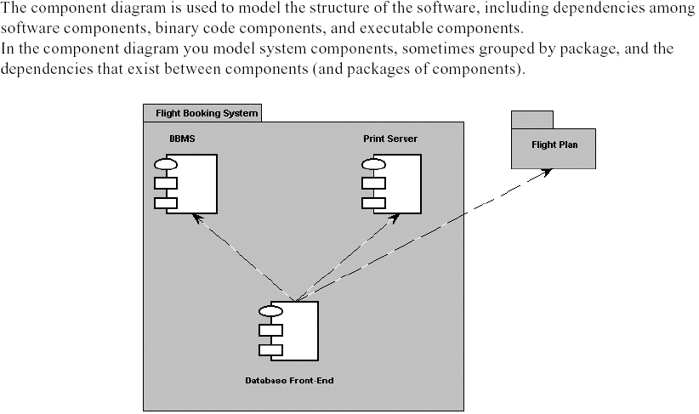
Component Diagram (combined with Packages)
“Print Server Software” would have been more clear
Dependency
Component containing executable software modules & objects

Slide 100
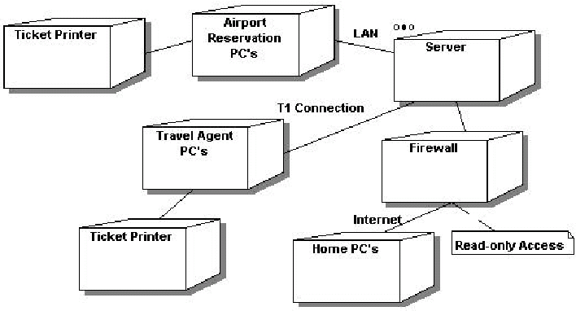
Deployment Diagrams
Hardware

Slide 101
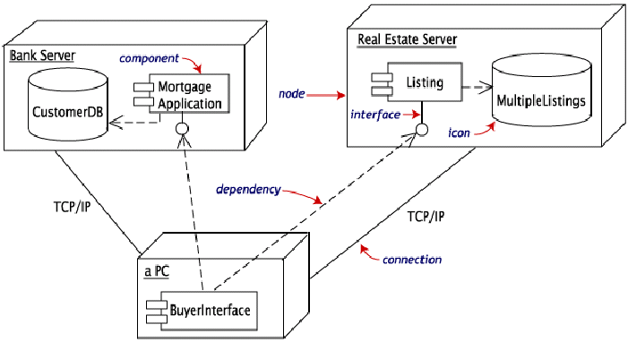
Combined Deployment-Component Diagram
Dependencies often implemented using “middleware”

